Slide 1
Sentiment Analysis and Classification of Yelp Reviews
By:
Daniel Youssef
206150

Slide 2
Table of Contents
The Problem Statement
Dataset
Data Exploration
Solution Methodology
Solutions
Sarcasm Detection
Future Improvements
Conclusion

Slide 3
Abbreviations Used
ML ➔ Machine Learning
DL ➔ Deep Learning
XGB ➔ Extreme Gradient Booster
CUST ➔ Custom Under Sampling Technique
LSTM ➔ Long-Short Term Memory
RNN ➔ Recurrent Neural Network
BERT ➔ Bidirectional Encoder Representations from Transformer

Slide 4
The Problem Statement
Develop an ML/DL Solution to the Sentiment Analysis Problem
Develop an unbiased method to allow models to predict different classes accurately
Train many models, on large amounts of data to achieve an accurate result

Slide 5



The Problem Statement
Most Solutions use very little data
Accuracy vs F1-Score
Data preparation is not prioritized

Slide 6
Dataset
Smaller Dataset
7619 Rows
Small-Scale Experiments
Sentiment Polarity
Specific to Coffee Shop Reviews

Slide 7
Dataset
Larger Dataset
6990280 rows
Training Models
Not Specific to any domain

Slide 8
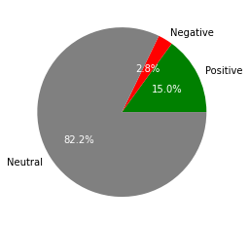
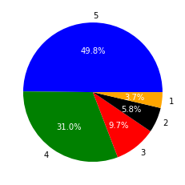
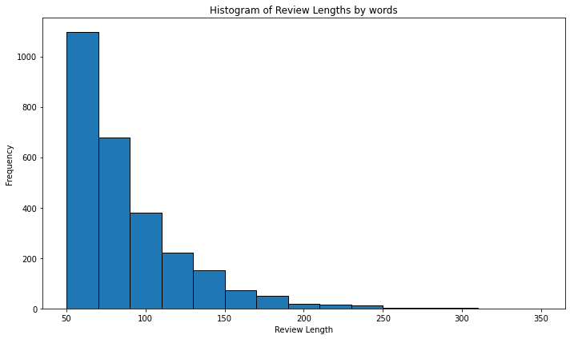
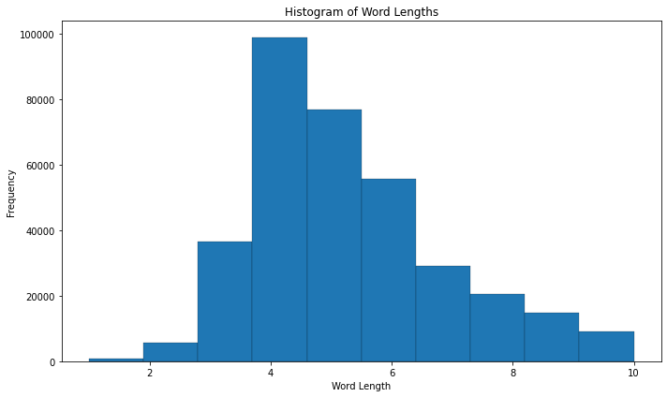
Data Exploration
Smaller Dataset
Distribution
Complexity of Reviews
Complexity Per Review

Slide 9
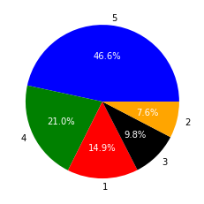
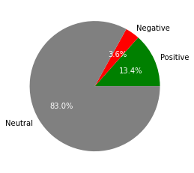
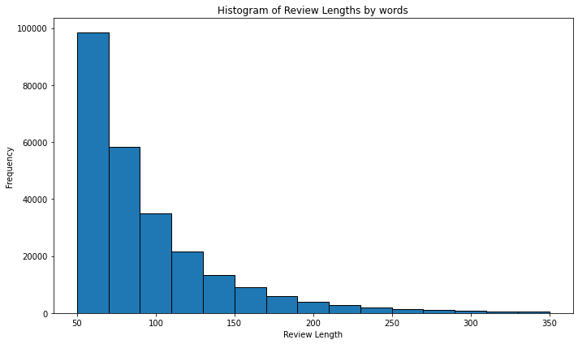
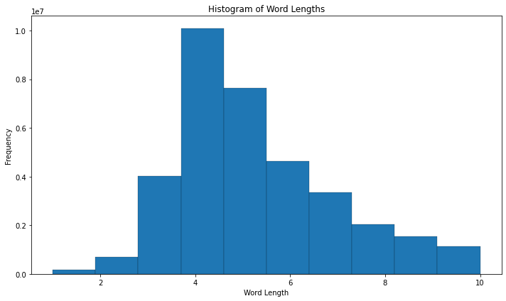
Data Exploration
Larger Dataset
Distribution
Complexity of Reviews
Complexity Per Review

Slide 10
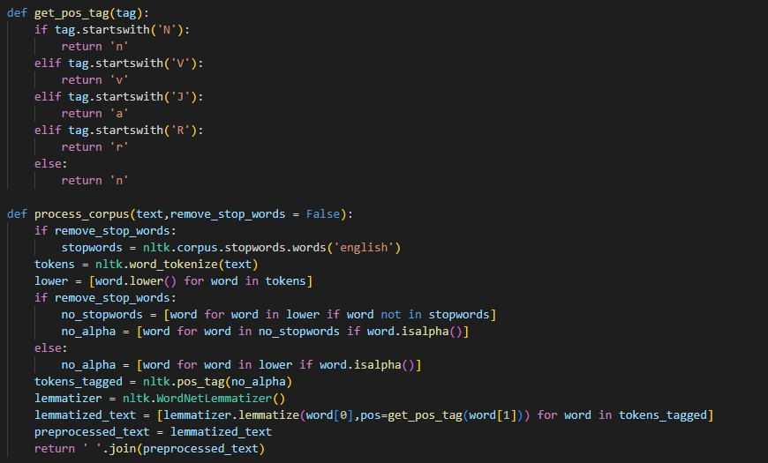
Solution Methodology
Both Datasets
1. Data Cleaning, and Pre-processing
SWAN? LEMA POSLOW!
Example:
Hi There! I am Daniel.
hi daniel

Slide 11
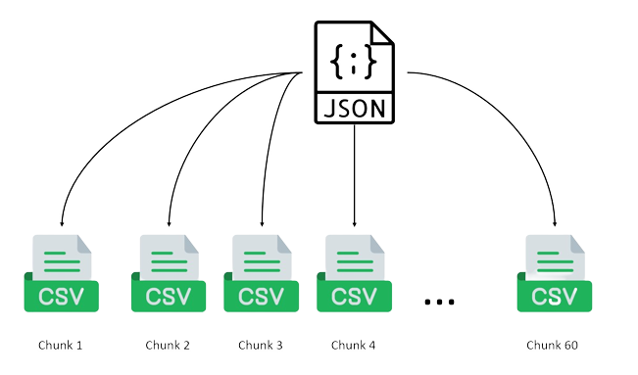
Solution Methodology
Larger Dataset
2. Data Sourcing
Backblaze was used for Sourcing
Data was split into 60 chunks

Slide 12
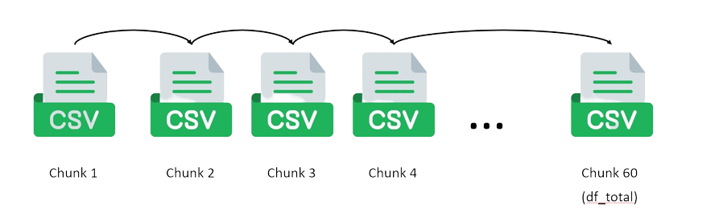
Solution Methodology
Larger Dataset
3. Data Preparation and Training
Vast.ai, and Google Colab were used for Training
All data is combined in virtual environment
3-labeled models vs 5 labeled models

Slide 13
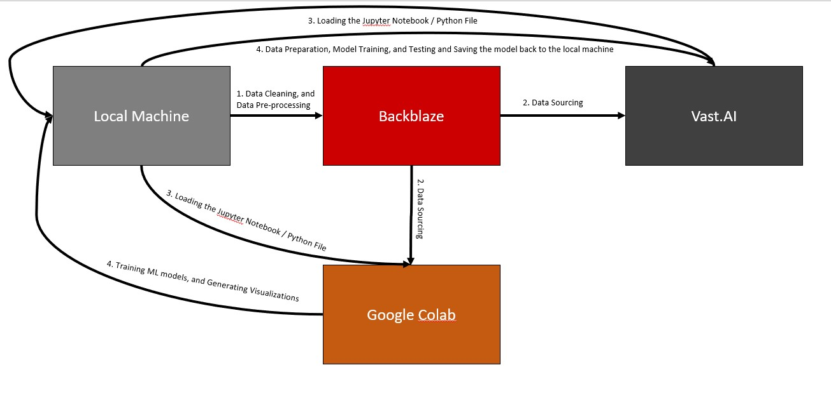
Solution Methodology
Backblaze vs Google Drive
Local Machine and Google Collab

Slide 14
Solutions
Smaller Dataset
Classifier | Accuracy Score
Multinomial Naïve Bayes (Optimized) | 0.59
Random Forest | 0.71
Support Vector Machine | 0.62
Bagging KNN | 0.54
Bagging MNNB | 0.58
Adaboost MNNB | 0.52
XGBoost | 0.85
SentimentIntensityAnalyzer | 0.82
Word2Vec
TF-IDF
SMOTE

Slide 15
Solutions
CUST Balanced
Classifier | Accuracy Score
Random Forest | 0.51
Logistic Regression | 0.69
Multinomial Naïve Bayes | 0.62
XGBoost | 0.70
Larger Dataset
Word2Vec
GloVe
Custom Under Sampling Technique (CUST)
6,990,280 ➔ 2,075,683
SMOTE Balanced
Classifier | Accuracy Score
Logistic Regression | 0.87
Multinomial Naïve Bayes | 0.79
XGBoost | 0.84

Slide 16
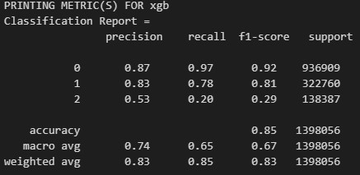
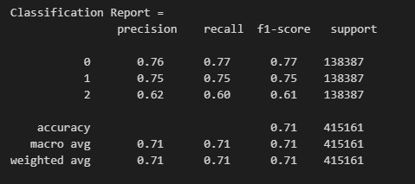
Solutions
Larger Dataset
Tradeoff between overall accuracy and F1-Score
Choice Depends on Use Case

Slide 17
Solutions
Larger Dataset
RNN Variant Number | Labels Count | F1-Score
Base Model | 3 | 0.74
Variant 1 | 3 | 0.62
Variant 2 | 5 | 0.59
Variant 3 | 3 | 0.73
DL Solutions
F1-Score ➔ Class Weights
Accuracy ➔ CUST
RNN Variant Number | Labels Count | Accuracy
Variant 4 | 3 | 0.72
Variant 5 | 3 | 0.73
Variant 6 | 3 | 0.76
Model | Accuracy Score
Multilayer Perceptron | 0.73
Bidirectional Encoder Representations from Transformer | 0.75

Slide 18
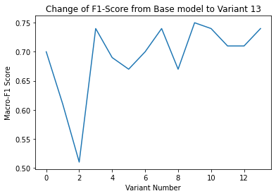
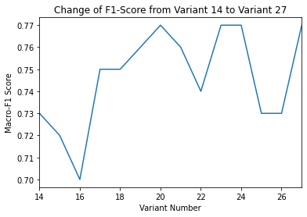
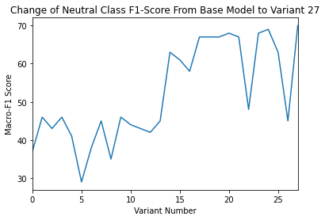
Solutions
Larger Dataset
LSTM
27 Variants
Variants 1-13 ➔ Class Weights
Variants 14-27 except 22 ➔ CUST
Why CUST?

Slide 19
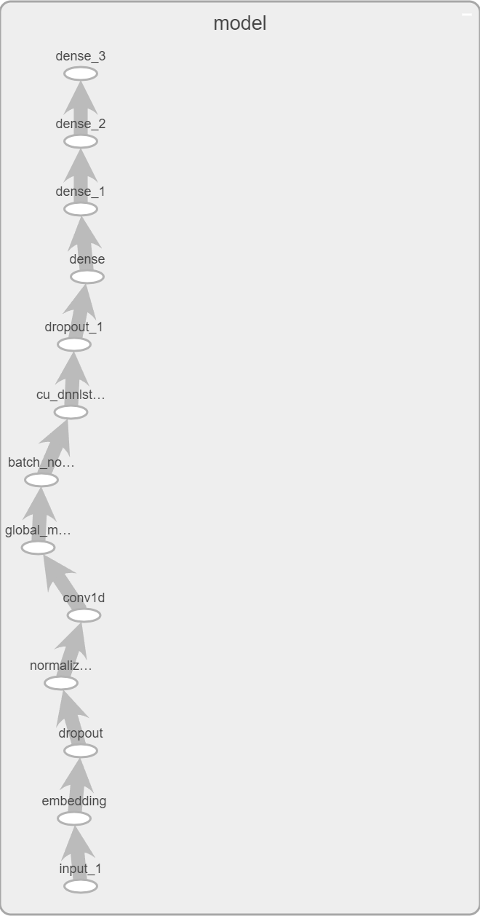
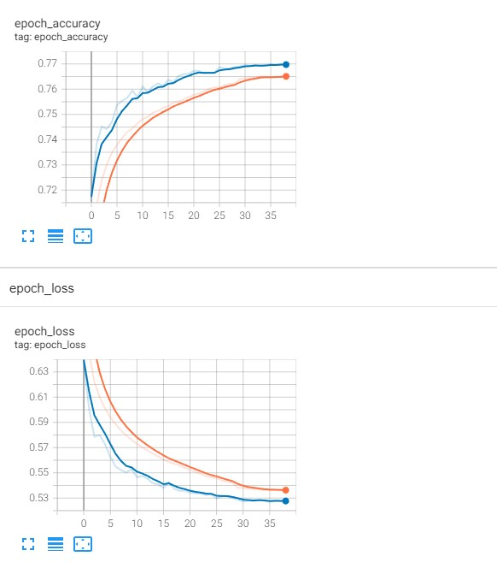
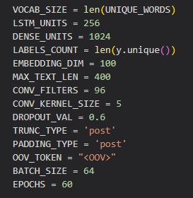
Solutions
Larger Dataset
Best Performing Variant: 27
Word2Vec > GloVe

Slide 20
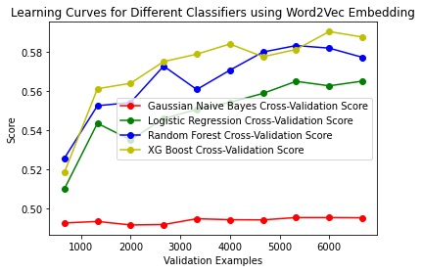
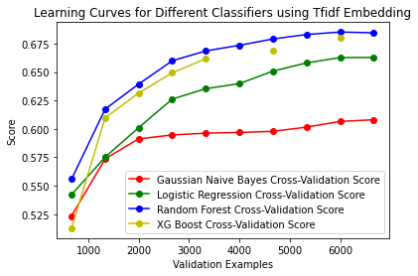
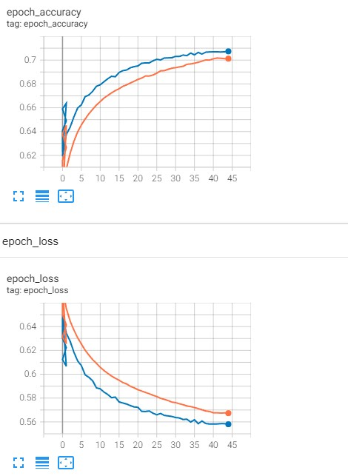
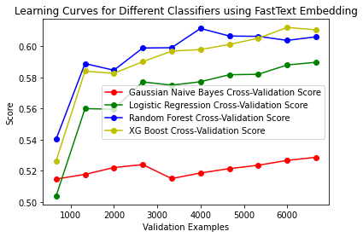
Sarcasm Detection
Detecting sarcasm in text
Follows the standard pipeline
Second part of Sentiment Analysis
New Embedding: FastText

Slide 21
Conclusion
Model Name | ML/DL | Accuracy | Macro F1-Score | Label Count | Dataset
XGBoost (SMOTE) | ML | 0.85 | 0.67 | 5 | Larger All
Bagging Multinomial Naïve Bayes (SMOTE) | ML | 0.80 | 0.68 | 3 | Larger All
Logistic Regression (SMOTE) | ML | 0.87 | 0.71 | 3 | Larger All
LSTM Variant 7 (CLASS WEIGHTS) | DL | 0.89 | 0.75 | 3 | Larger Subset
LSTM Variant 27 (CUST) | DL | 0.77 | 0.77 | 3 | Larger All
Model Name | ML/DL | Accuracy | Label Count | Dataset
XGBoost | ML | 0.71 | 3 | Sarcasm Subset
LSTM Variant 1 | DL | 0.71 | 3 | Sarcasm All
Sentiment Analyser | Score
Larger Dataset Full (SMOTE) | 0.75
Larger Dataset Full (CUST) | 0.44

Slide 22
Future Improvements
GUI
More optimization of ML/DL models
More thorough Data Cleaning
Experiment with more embeddings for Sentiment Analysis using DL
Find better ways to improve neutral class prediction without under sampling

Slide 23
Thank You
Questions?

